Slide 1
HR Data Analytics – IBM Dataset
By: Sara banadaki and Naim Syed

Slide 2
Project Plan
Goal:
Using an HR dataset provided by IBM, we will address the following questions:
What metrics can be used to help predict an employee's upcoming salary increase (using a regression model)?
Bonus: Predicting Attrition (whether an employee will leave/stay) using a classification model.

Slide 3
Project Process
Dataset Evaluation/Quality Assurance Process
Performance EDA
Regression Model (Backwards Selection Process)
Classification Model (Using Randomforestclassifier)
Tableau Dashboard

Slide 4
Dataset Evaluation/Quality Assurance
General review (i.e formatting, understanding values, etc)
Checking null counts on all columns
Validating age (applying reasonable limits on age columns)
Reviewing appropriate datatypes
Checking for duplicates in EmployeeID
Dropped irrelevant columns (i.e only one value such EmployeeCount containing one's and StandardHours containing 80’s).
Transformations: Percent columns were converted into decimal formats.
Encoding: During models, categorical data was converted using label encoding.

Slide 5
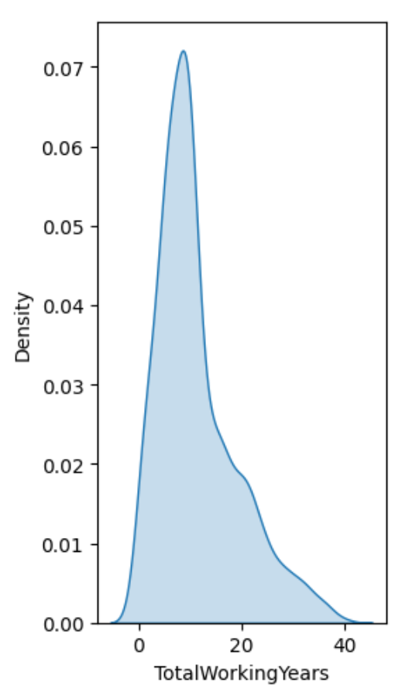
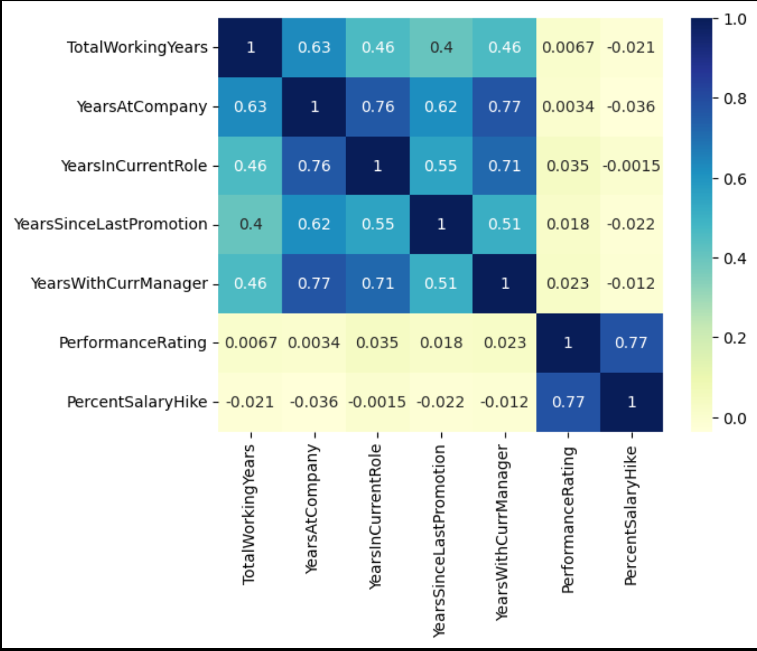
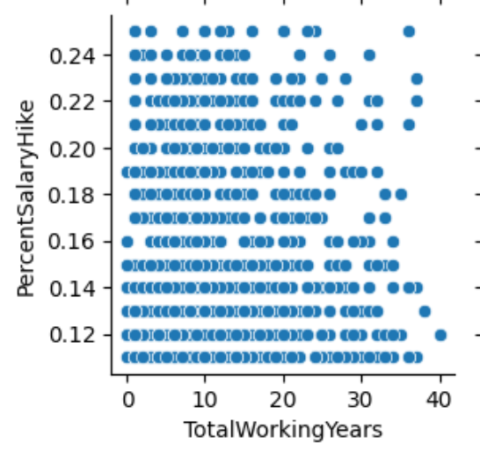
Performing EDA – Salary Hikes (Regression)

Slide 6
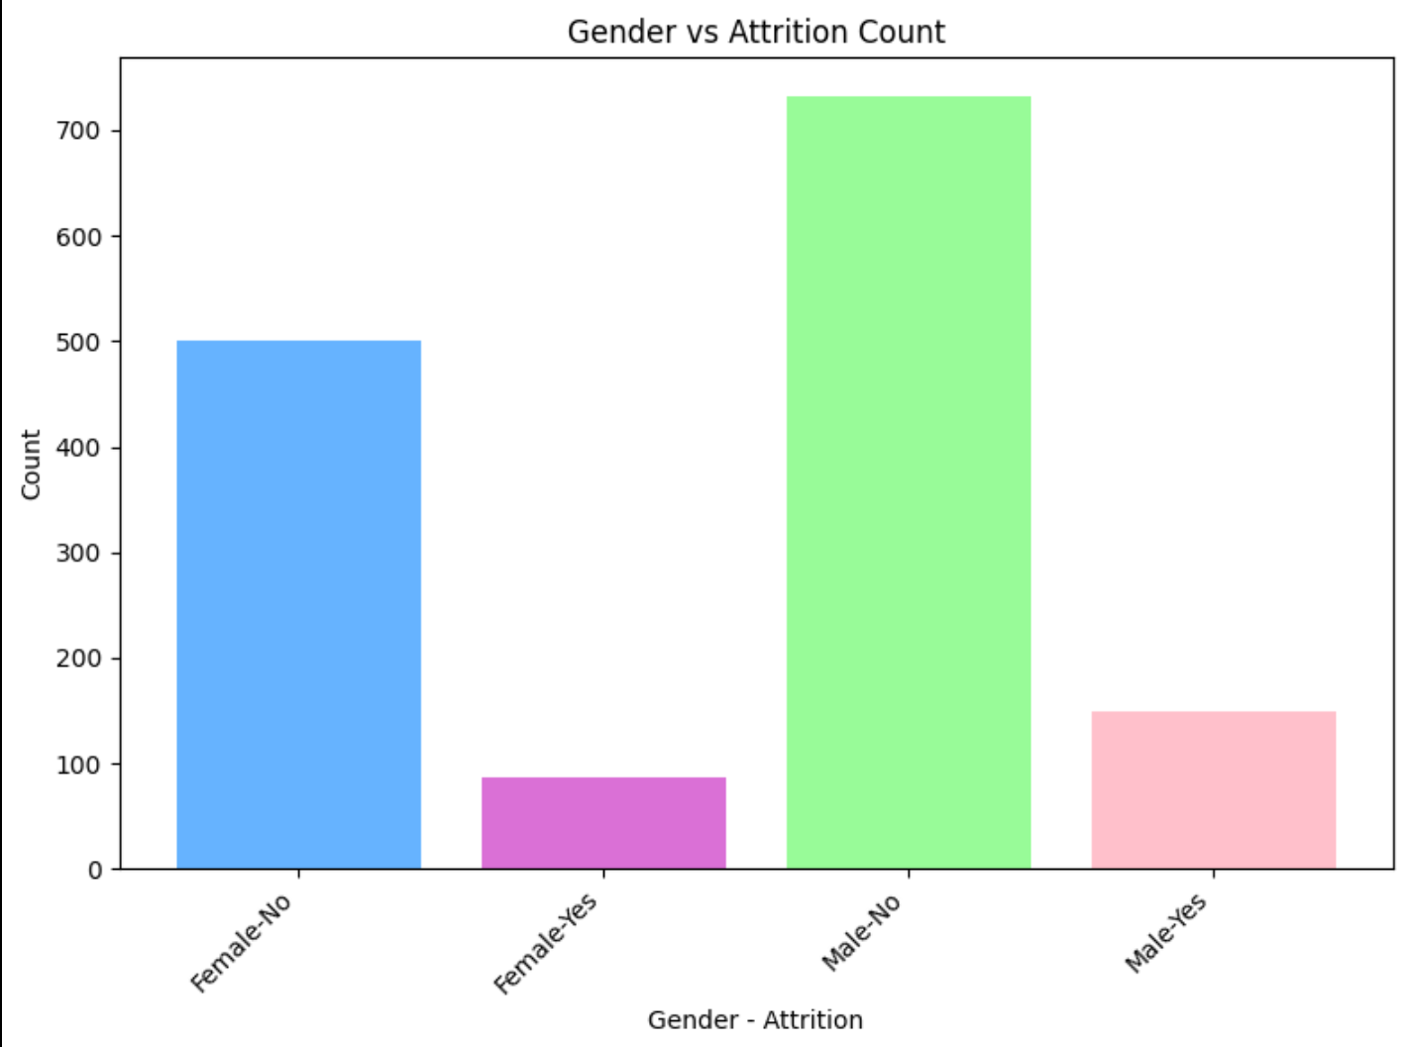
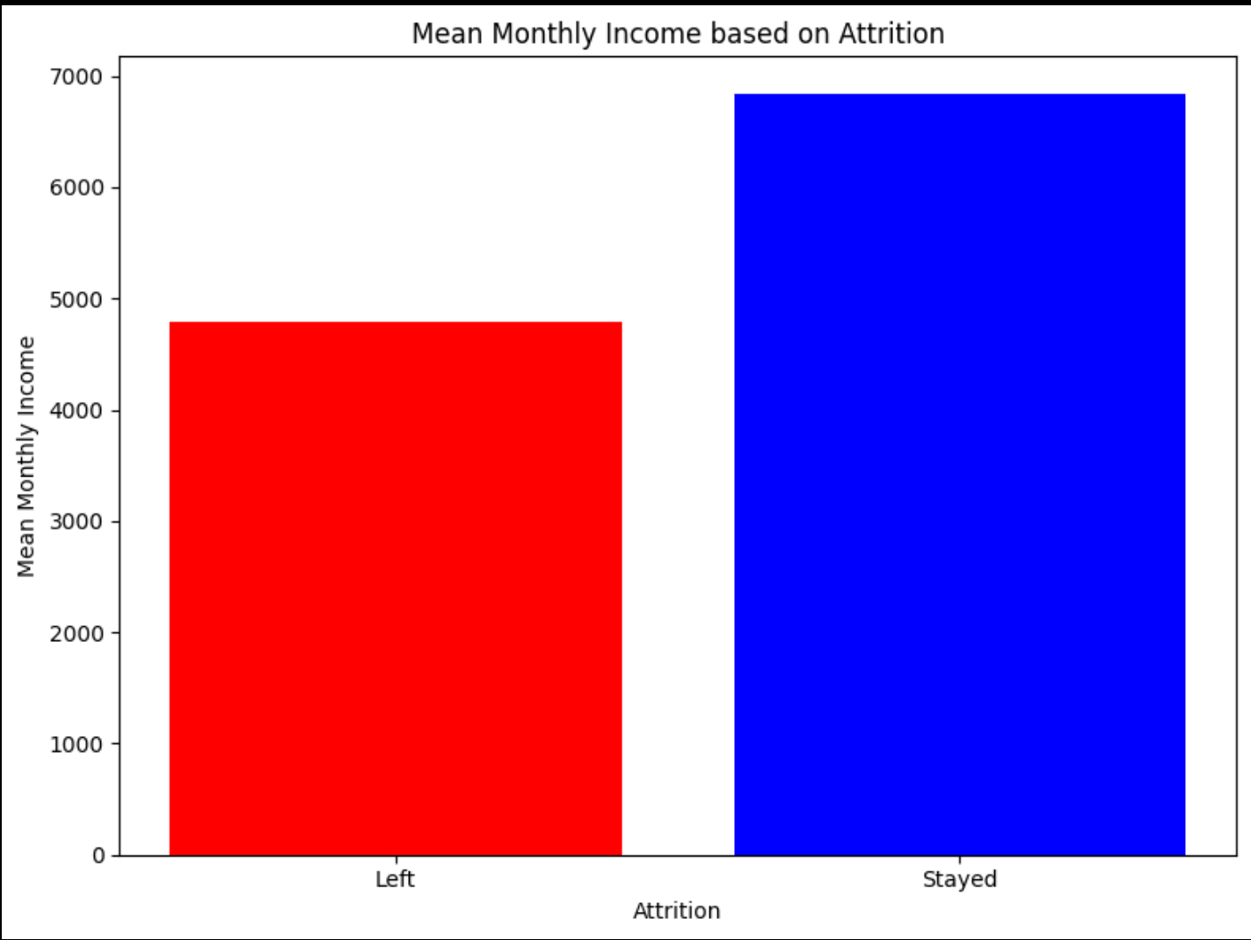
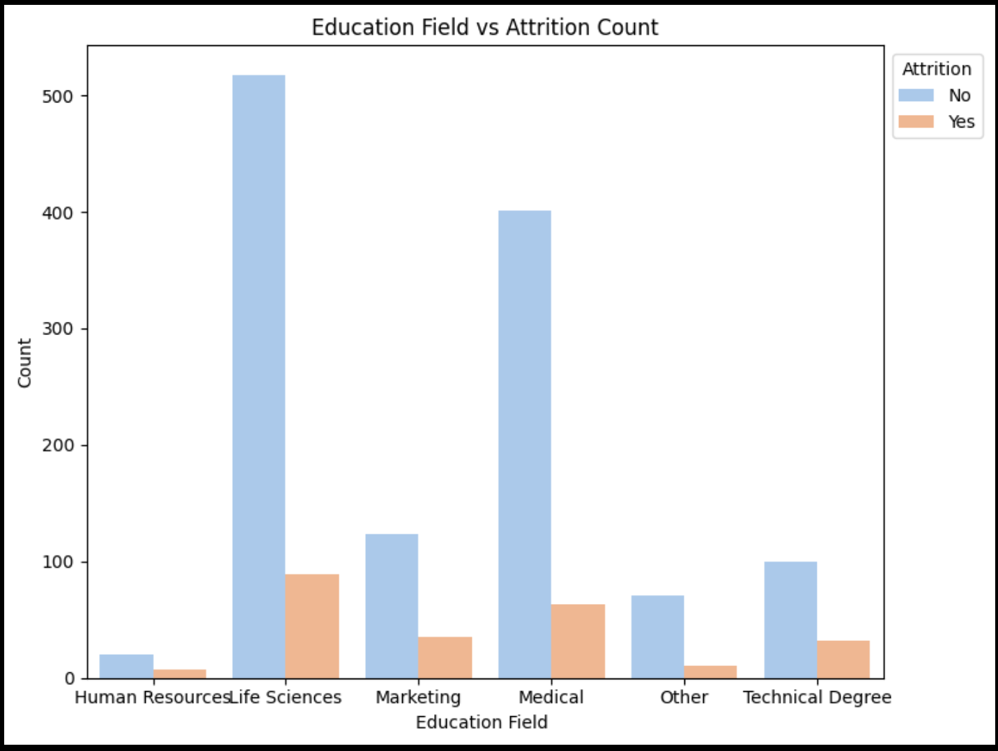
Performing EDA – Attrition (classification)

Slide 7
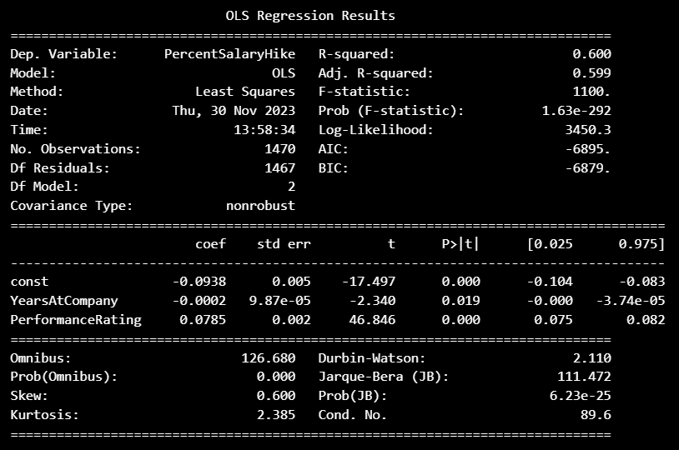
Regression Model – Salary Increase
After applying backwards selection, the final model results were left with 2 variables that were considered significant: YearsAtCompany and PerformanceRating
This means that these two variables would be the key variables for the company to use when predicting an employee’s upcoming salary increase.

Slide 8
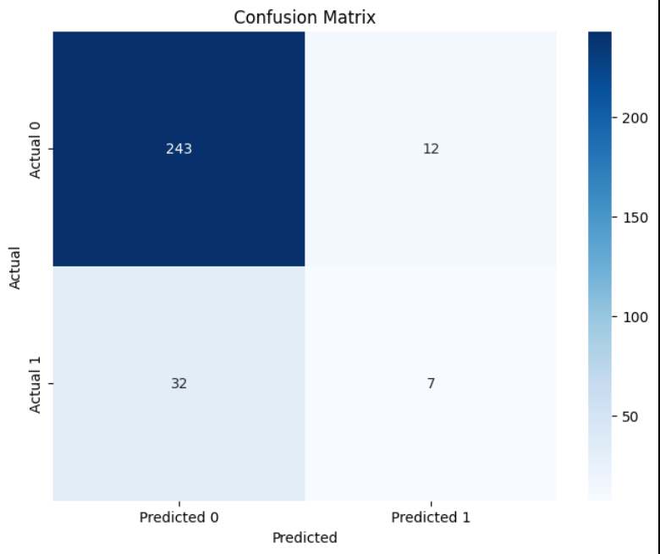
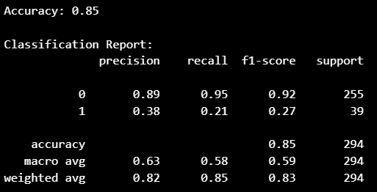
Classification Model – Attrition
Set up a classification model using Gender, Age, PerformanceRating, EducationField, MonthlyIncome, OverTime as the key metrics for predicting attrition.
The model accurately predicted 85% of the outcomes based on a test set of 20% of the original dataset while running 100 predictions.

Slide 9
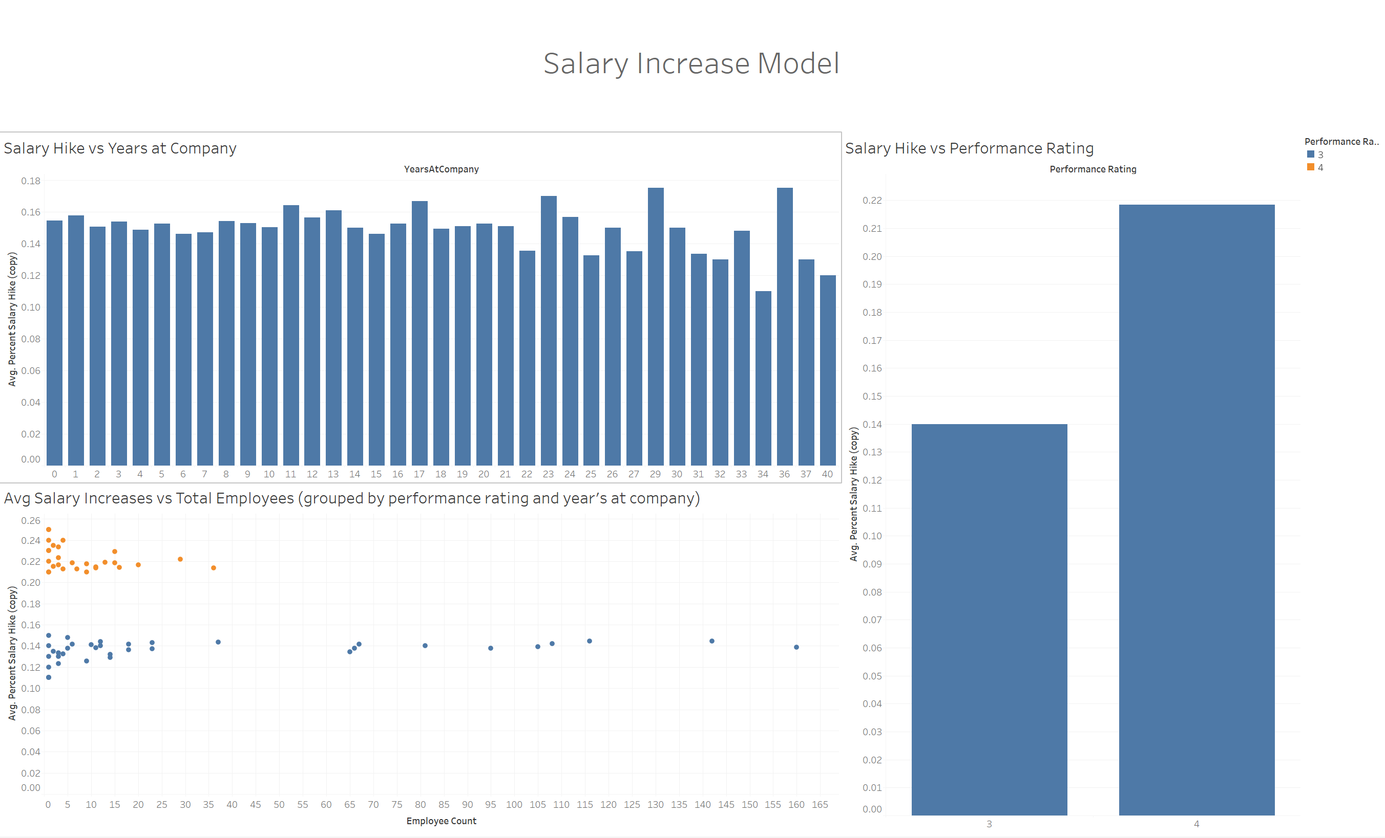
Salary Increase Dashboard

Slide 10
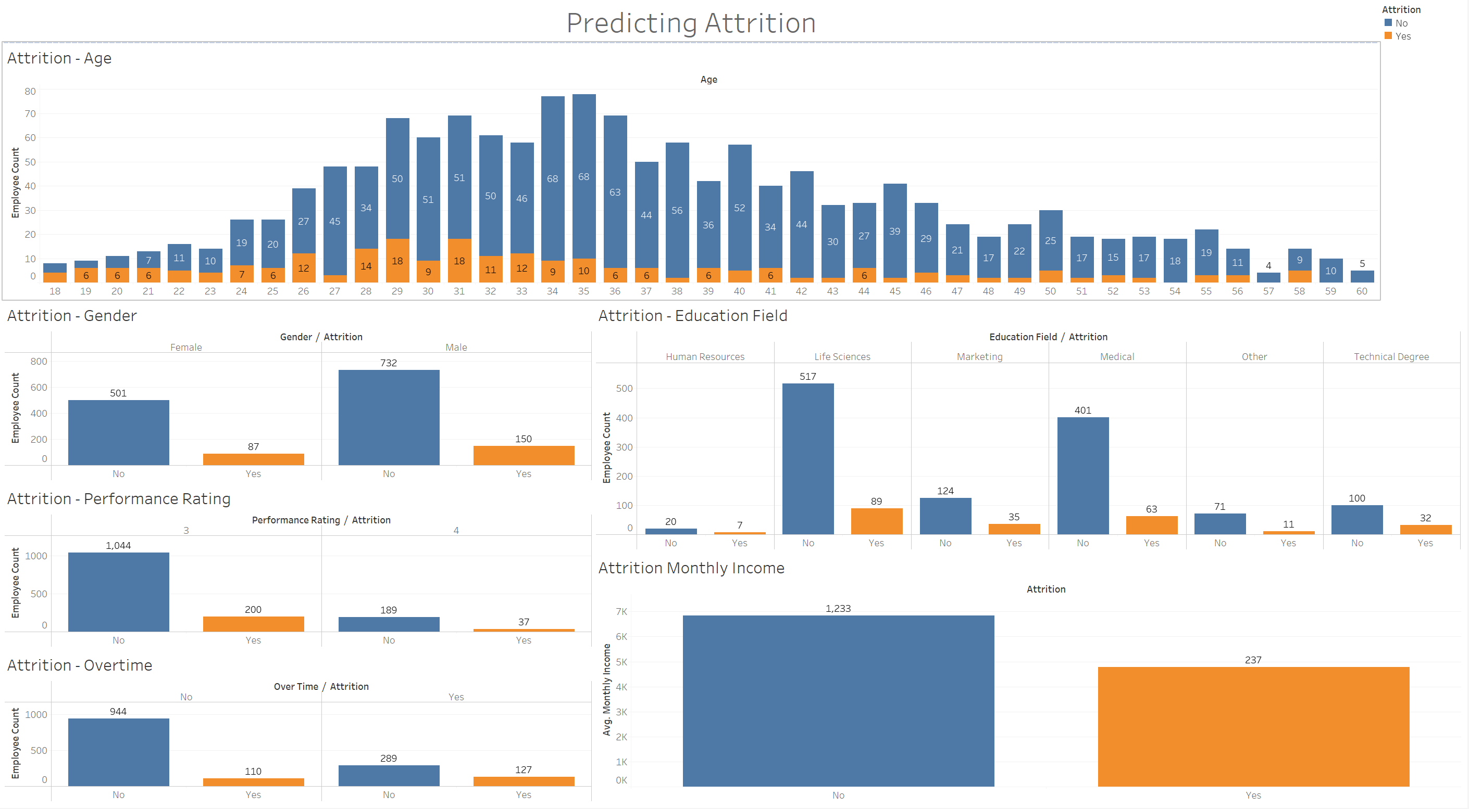
Attrition Dashboard

